Slide 1
Neural Networks From Scratch Pt. 2
Review, Layers, Activation Functions, Loss Functions, and calculating network accuracy!
Robert Moseley
California Baptist University
College of Engineering

Slide 2


My setup
Register for a student license
https://www.jetbrains.com/community/education/#students
I use Jupyter Notebooks for the coding (just a file type)
Google CoLab is another great option!
https://colab.research.google.com/

Slide 3
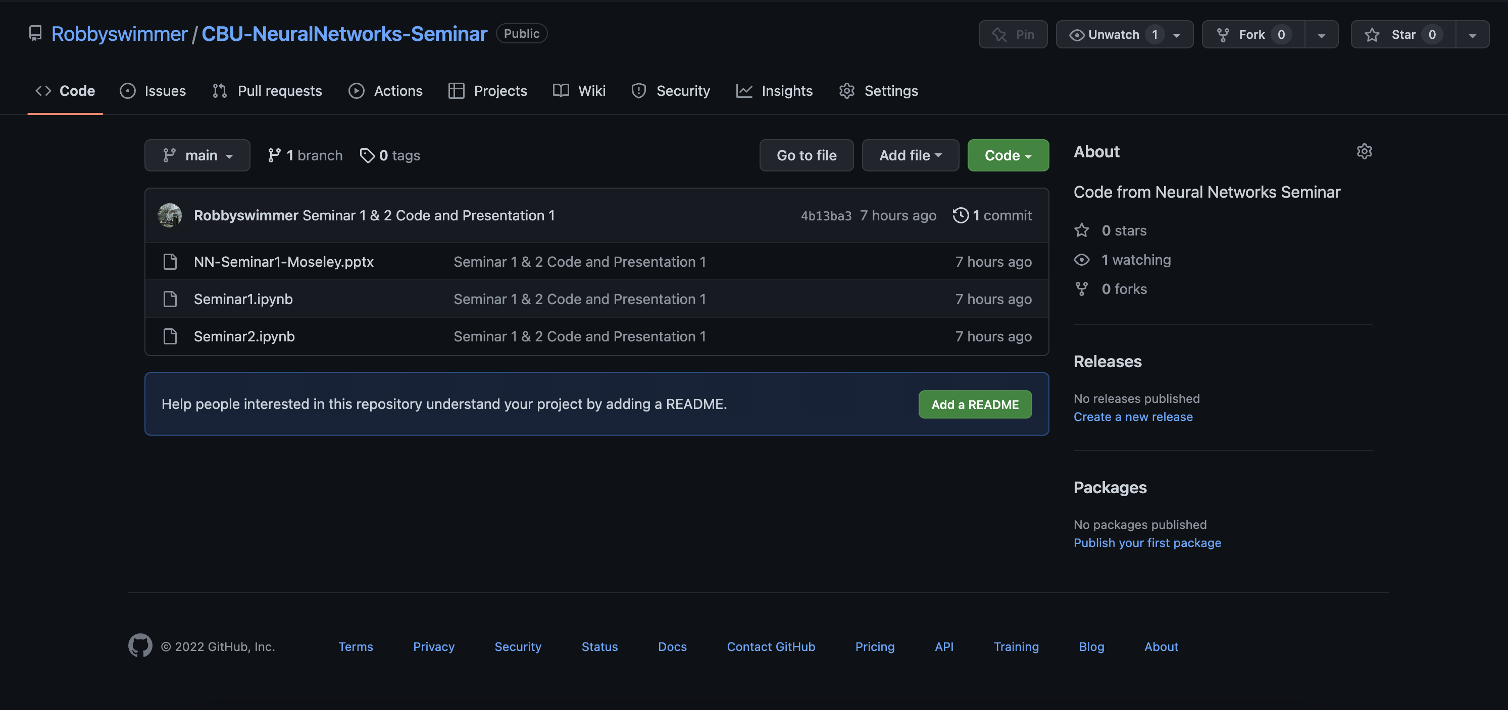
Github Link: https://github.com/Robbyswimmer/CBU-NeuralNetworks-Seminar

Slide 4
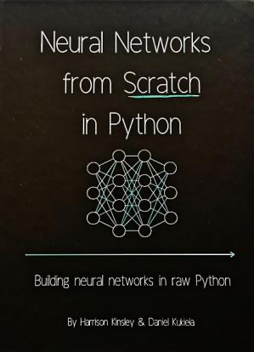
Materials for following along…
How to Follow Along:
Use any laptop
Python 3.7 or later
Numpy v1.15.0 or later
No Experience required
Book we will be learning from:
- Neural Networks from Scratch in Python (Harrison Kinsley & Daniel Kukiela)

Slide 5
Big Picture for Today
How can we create layers of neurons and connect them?
How can we change the outputs of the neurons?
How do we know if our neural network is working or not?

Slide 6
Review…

Slide 7
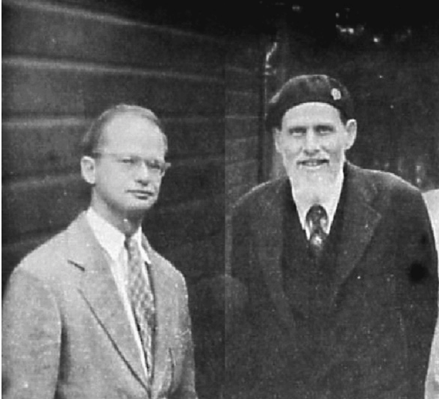
Time for a History Lesson
Neural Networks first proposed in 1944 by Warren McCulloch and Walter Pitts
University of Chicago Researchers who later started MIT Cognitive Science Lab
Just an idea at first, nobody knew how to actually train the networks for 20 more years
Notes:
Neural Networks or Artificial Neural Networks (will be using the term Neural Networks, but they are interchangeable)
First proposed by Warren McCulloch and Walter Pitts in 1944 who were Cognitive Scientists at the University of Chicago and later moved to MIT to start their Cog Sci Lab
Neural Networks originated in the 1940s, but nobody could figure out how to train them until nearly 20 years later when backpropagation was invented (something we will get into in the next meeting time)
Basically, it was only a theory that people thought could be really useful, but nobody could figure out how to implement the theory (computers weren’t powerful enough anyway)
Neural networks took until nearly 2010 before they started to become popular (this is when they started to win competitions against actual humans)
McCulloch and Pitts built on ideas from Alan Turing’s book “On Computable Numbers” and demonstrated how brain functions could be described in the context of formal mathematics

Slide 8
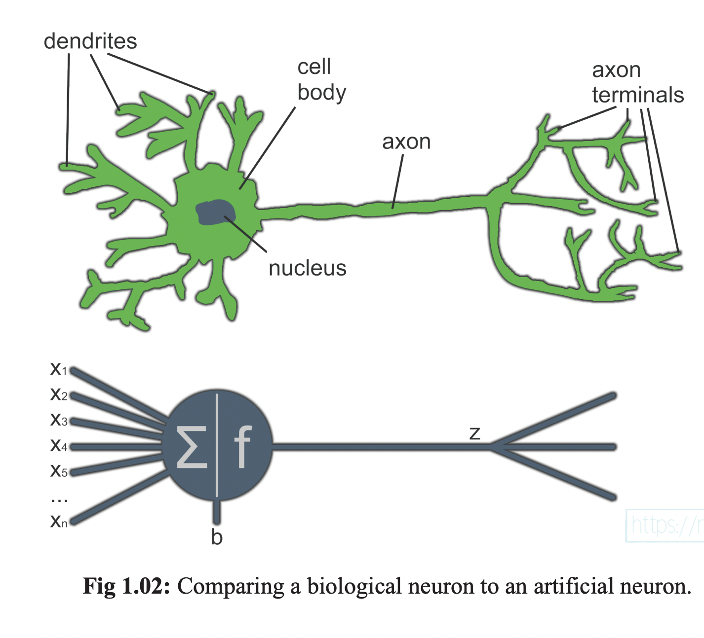
Neural Networks are based upon the structure and functionality of biological neurons
Notes:
While a biological neuron might have dendrites and cell bodies for processing inputs, a neural network relies upon mathematical functions to handle the same processes

Slide 9
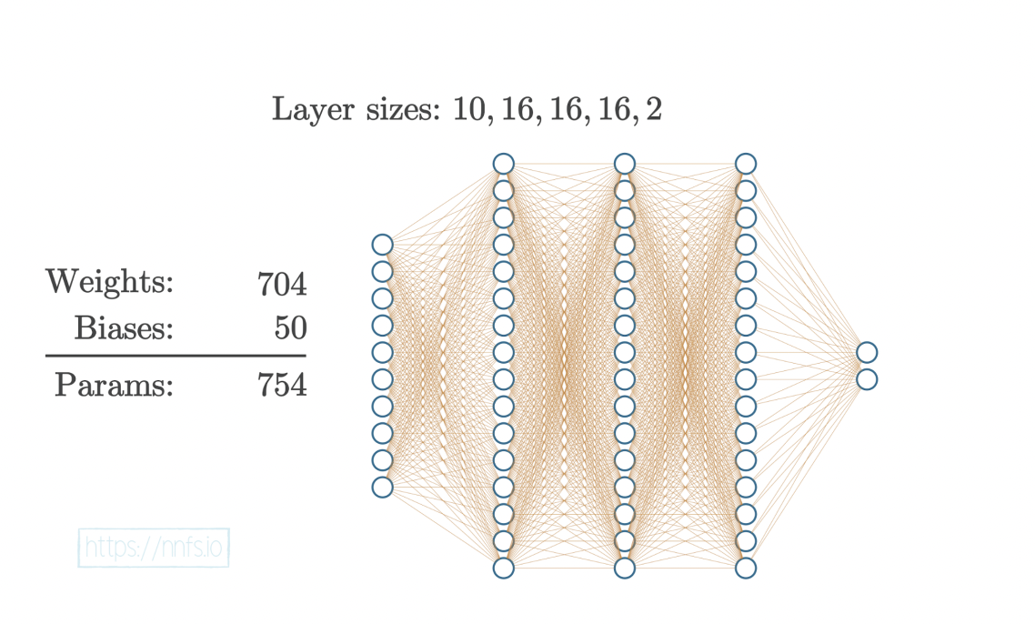
Neural Network Structure is inspired by the Brain
They are comprised of layers upon layers of individual neurons where each neuron has the responsibility of communicating a signal to the rest of the network
Notes:
Neural networks have different layer types:
1) Input layers
2) Hidden layers
3) Output layers
Input layers is where data starts out in a neural network – it is given in its raw, unfiltered form before the network manipulates it
Hidden layers are inaccessible to the creator of the network – these layers are responsible for parsing the input data and manipulating it until the data makes sense
Output layers are where the perceived answer generated by the network is actually read from
If you are performing classification, say dogs and cats, then one neuron represents that the network thinks it found a dog, and the second neuron represents that it thinks it found a cat
This network featured above represents what we would call a fully connected neural network because each node in one layer is connected to every node in the previous and subsequent node layers. The output of each node, becomes the input for its connecting node until the output layer is reached.
There are many different types of neural networks including recursive neural networks (which is best used for time series data), convolutional neural networks (best used on images and videos – think Tesla self-driving cars), Long Short-Term Memory (LSTM) which are great at shorting long sequences of data
We will focus on simpler neural networks, like the one featured in this picture, to keep explanations a little bit simpler

Slide 10
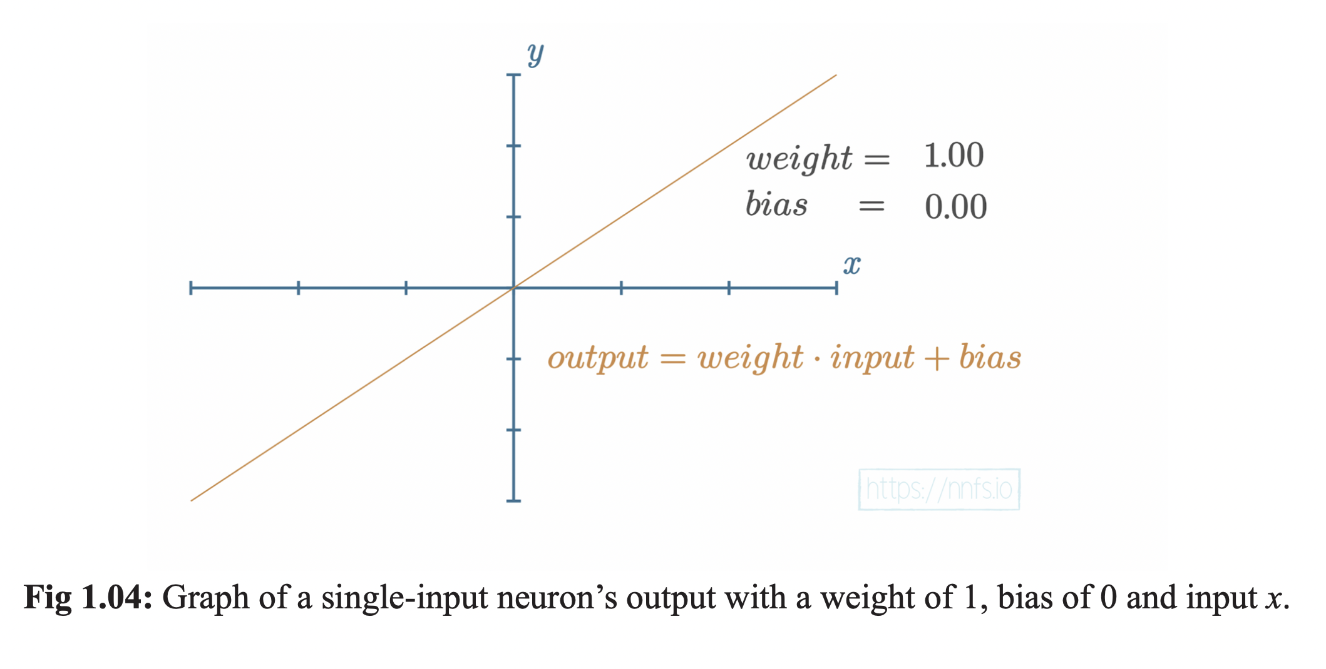
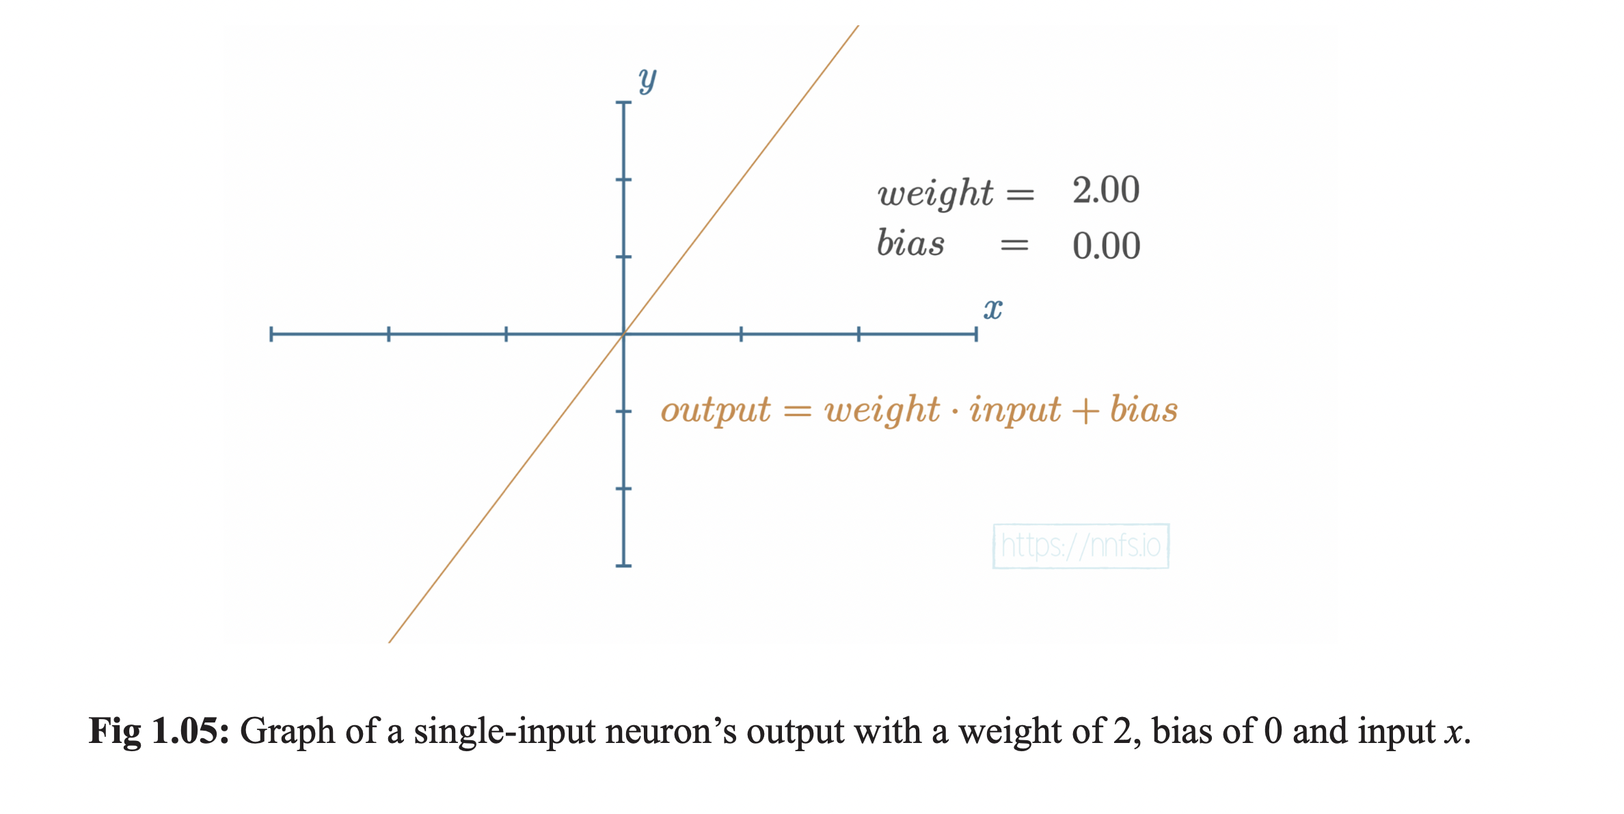
Notes:
Neurons are just numbers!
They are composed of weight and bias and training a neural network is basically just the process of changing these numbers
using mathematical functions
As you increase the value of the weight, the slope will simply get steeper. If the weight is decreased, the slope will decrease
Similarly, if the weight is negated the slope will turn negative!

Slide 11
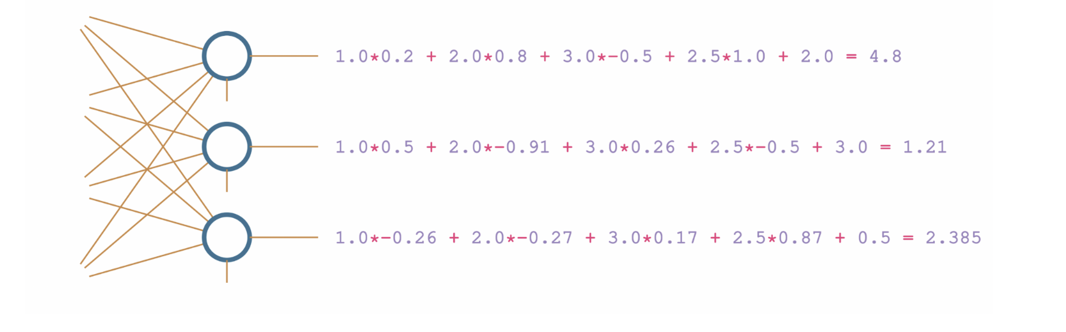
Summary of Neuron Layer created in first lesson

Slide 12
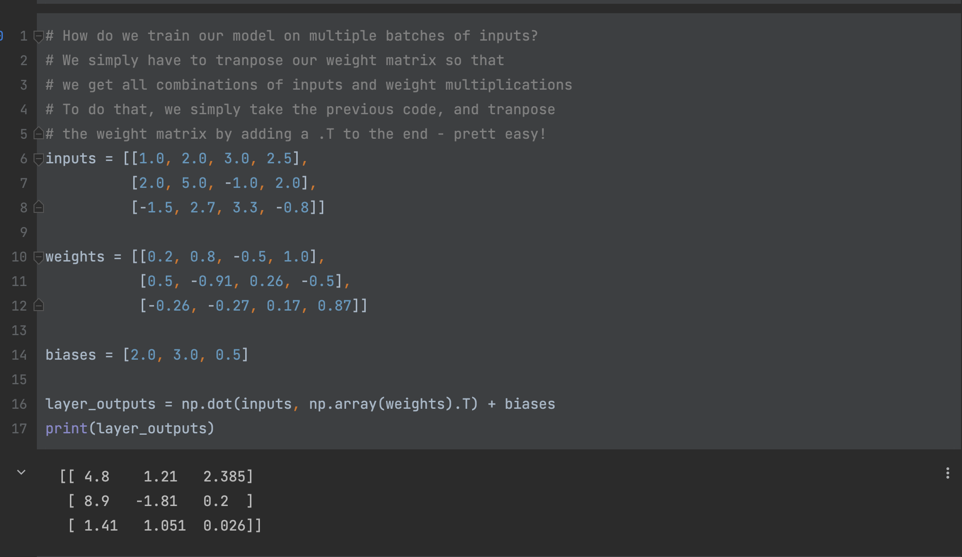
Neuron Layer in Python
Notes:
During this coding process we figured out how to efficiently calculated dot product and correctly transpose the weights layer so that it
Is the correct shape for multiplying with the inputs

Slide 13


How do we add more layers to our network, so it looks more like a normal network?
Notes:
Last week we talked about how we add more neurons to a layer, right? We just had to add a new weights and new inputs and we had new neurons?
But what if we want to add entire new layers of neurons to our existing network?

Slide 14
A Deep Neural Network is one that contains 2 or more hidden layers
Notes:
How many hidden layers does the network have? Reminder: a parameter is a weight + bias combo (not individual neurons)

Slide 15
Based on the code from last week, how do we add another layer?
Notes:
During this coding process we figured out how to efficiently calculated dot product and correctly transpose the weights layer so that it
Is the correct shape for multiplying with the inputs

Slide 16
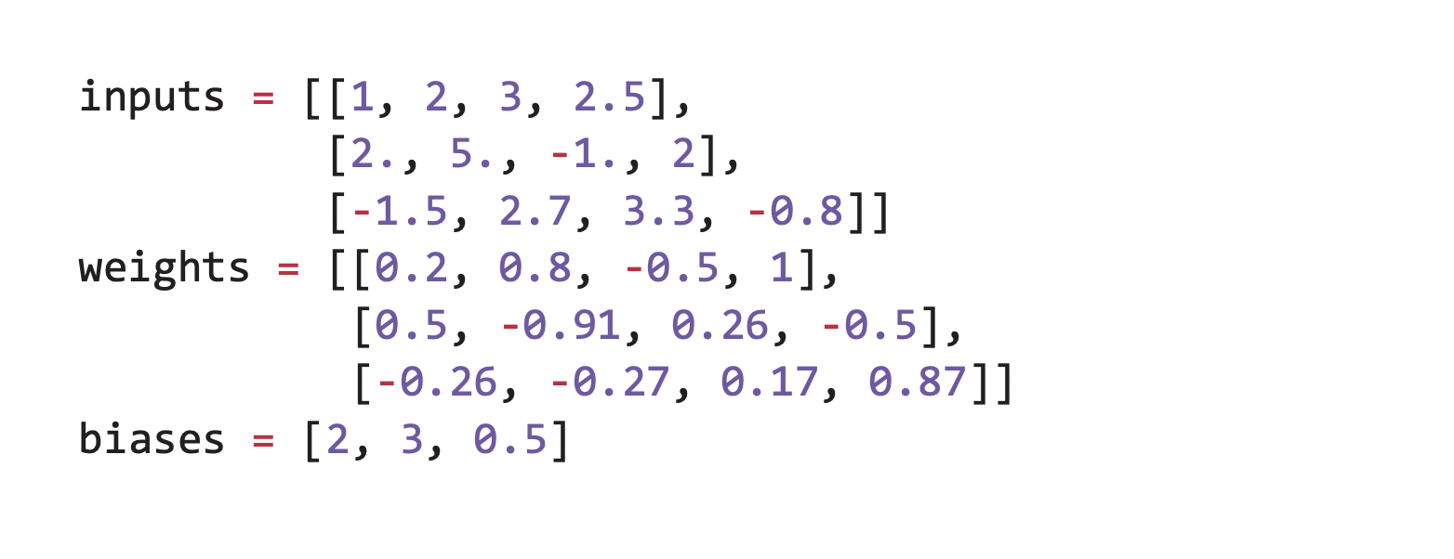
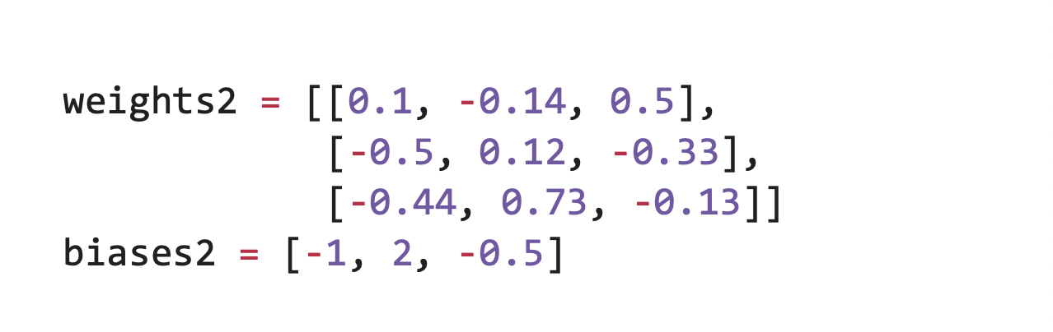
Adding Layers is actually really easy…
Notes:
Why is there only one array of inputs? Why doesn’t the second layer have inputs?

Slide 17
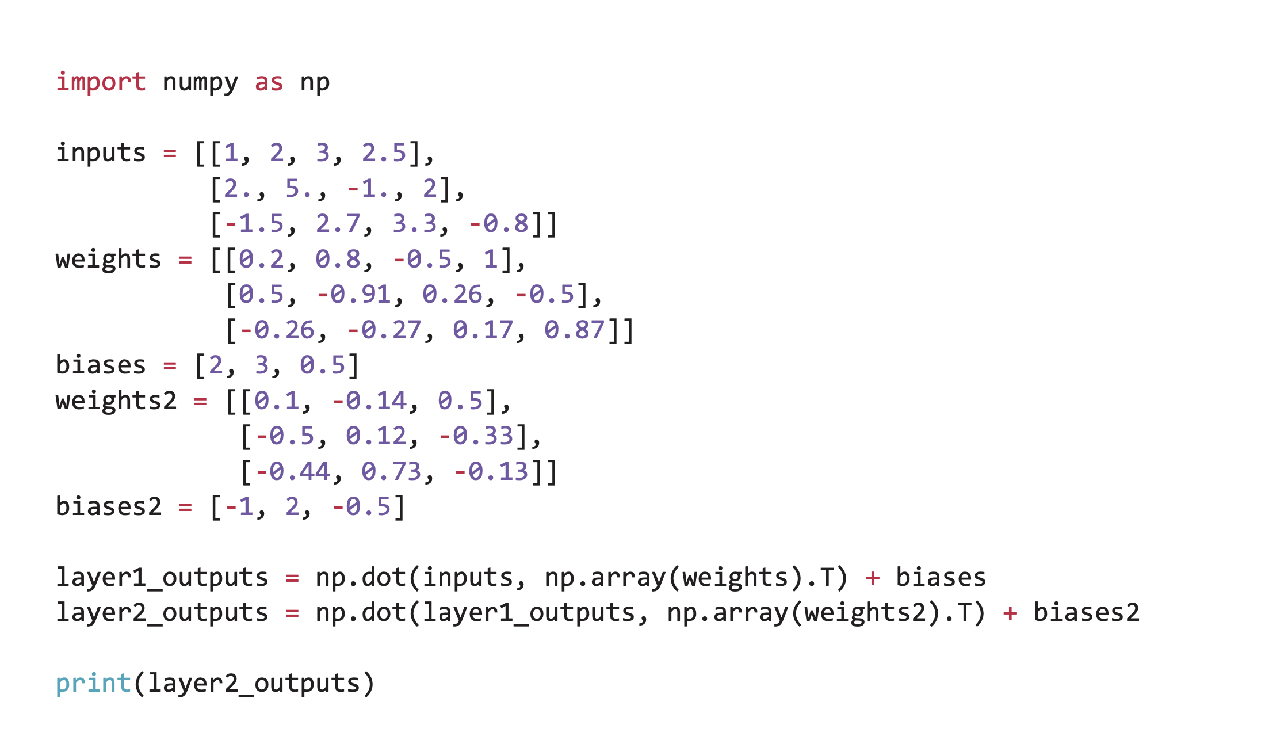
Our new Code…

Slide 18
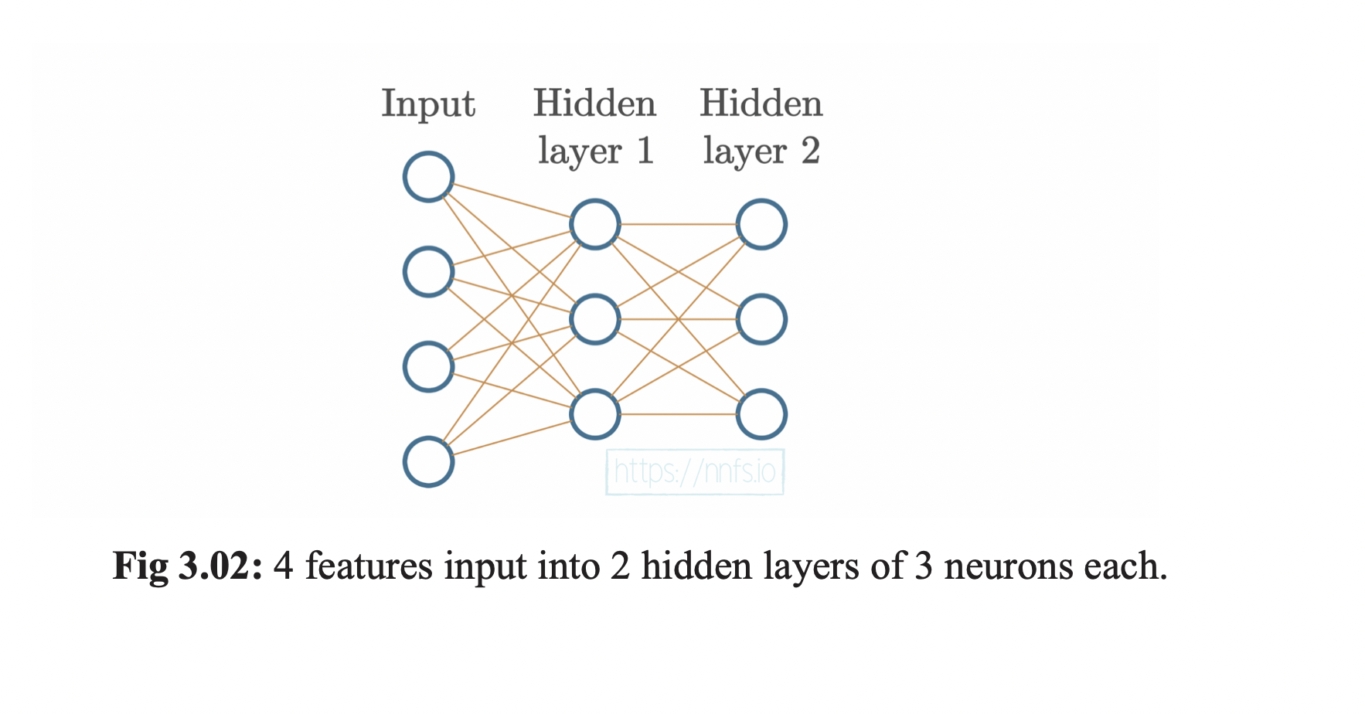
What does our new network look like?

Slide 19
Questions?

Slide 20
Coding Break

Slide 21
Activation Functions: What are They and why do we need them?

Slide 22
What you need to Know:
Activation functions are applied to neuron output
If we use a nonlinear activation function, it will create hidden layers that adapt to nonlinear functions
There are two types you need to know: 1) hidden layer activations, and 2) output activations
Mimics the binary output of an actual neuron (on or off)

Slide 23
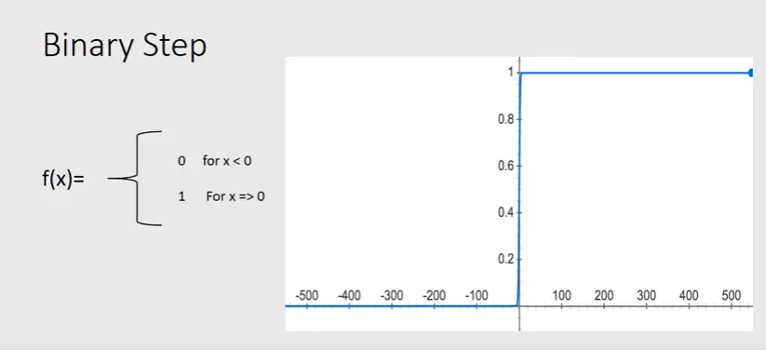
Simplest Activation function is the Binary Step Function
Notes:
The binary step function outputs 1 for values greater than or equal 0, and 0 for values less than 0
In the past this activation function would often be applied to hidden layers, but is not really used anymore because there are now better options for hidden layers

Slide 24
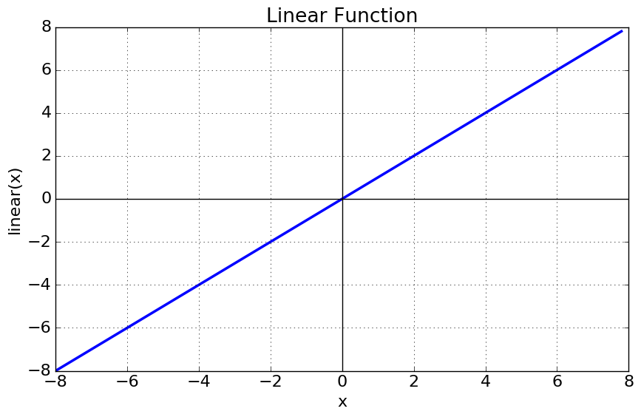
Another activation is the linear activation function
Notes:
This function would often be applied to a regression type neural network in the output layer
Regression models output numbers instead of classifications
This means that while some models might output a choice (like cat or dog) this model outputs a number, often representing a probability or it could be something like the predicted price for a house based on the number of bedrooms it has or something like that

Slide 25
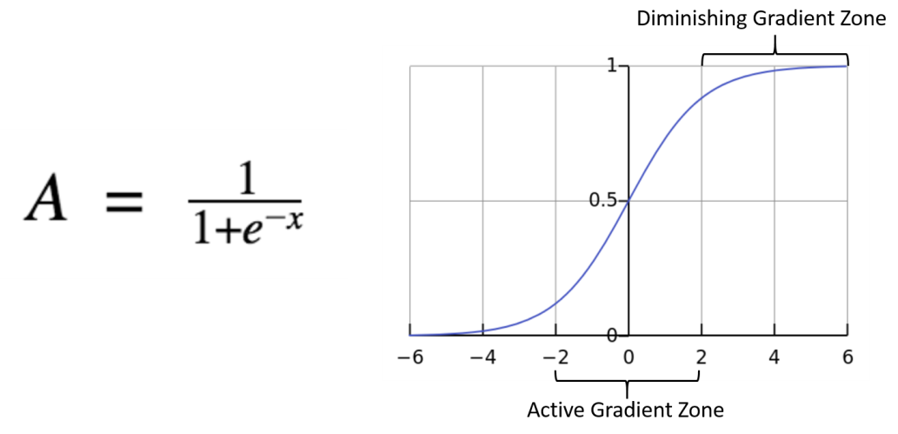
A better type of activation function is the Sigmoid Function
Notes:
Sigmoid functions give you better information about what is actually happening in the network because they can output floating point numbers, not just 0’s and 1’s, so you can see the actual impact that a data point might be having on the output of your network
Values less than 0.5 are returned as negative numbers, while numbers greater than or equal to 0.5 are returned as positive values
One of the other nice things about this function is that it is completely reversible, meaning that you can restore a network to a previous step if something bad occurs in the training process

Slide 26
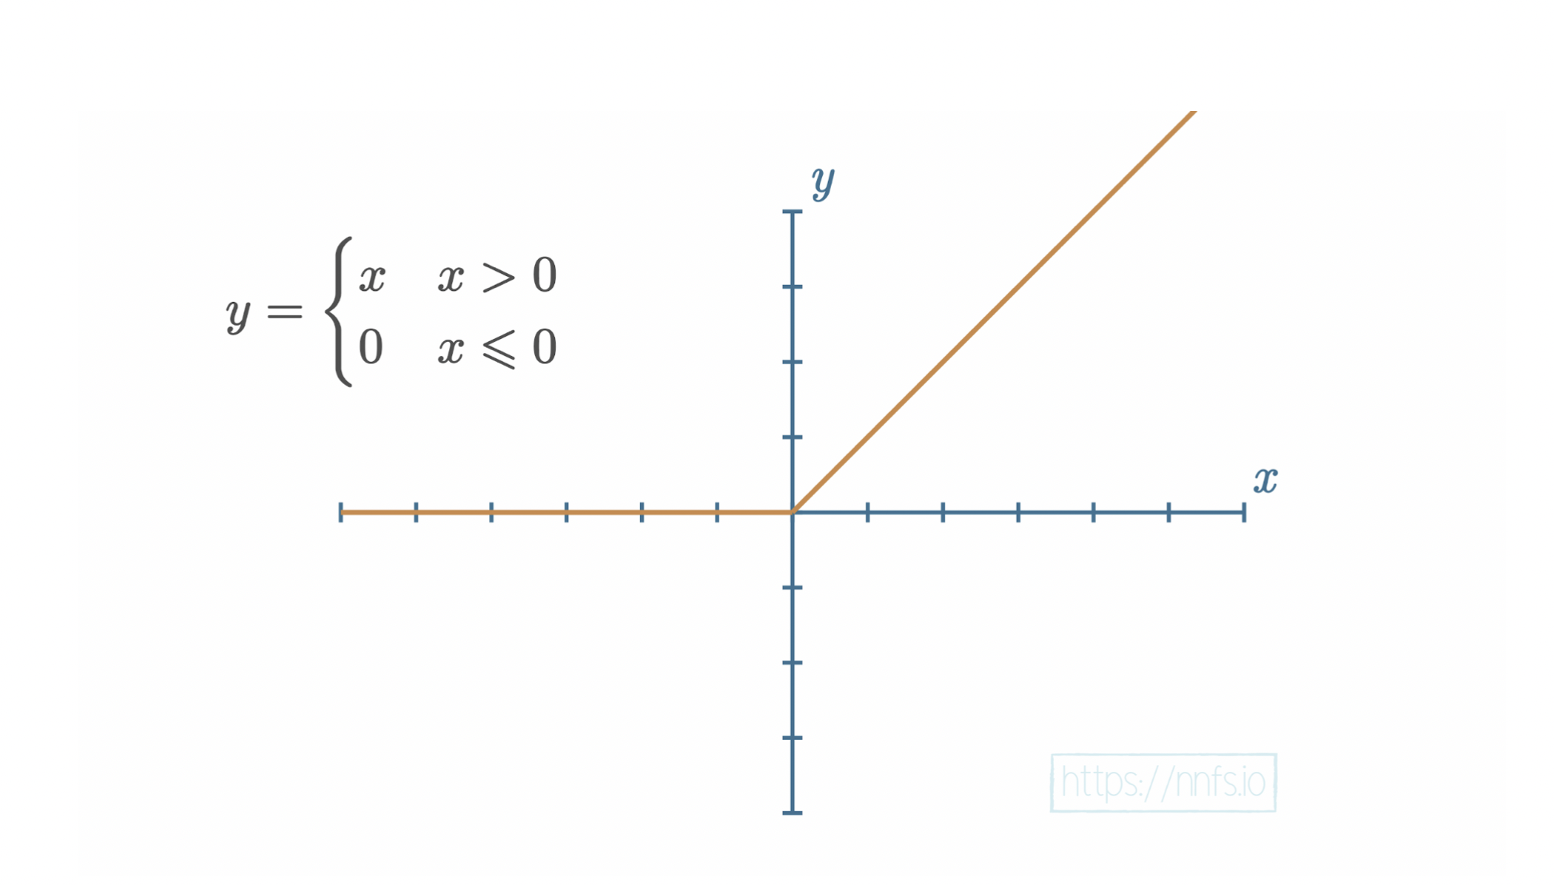
The most important, ReLU (Rectified Linear Unit) Activation function
Notes:
This function returns a 0 for values less than 0, and a linear output for values greater than 0 (y = x)
It is simpler than sigmoid, easier to calculate, and is currently the most popular activation function used by machine learning engineers and data scientists
It is as close to being linear as possible, without actually being linear (due to values less than 0 being treated as 0)
While Sigmoid is not difficult to compute, the time savings of ReLU really add up when it is being computed millions or billions of times to train a model

Slide 27
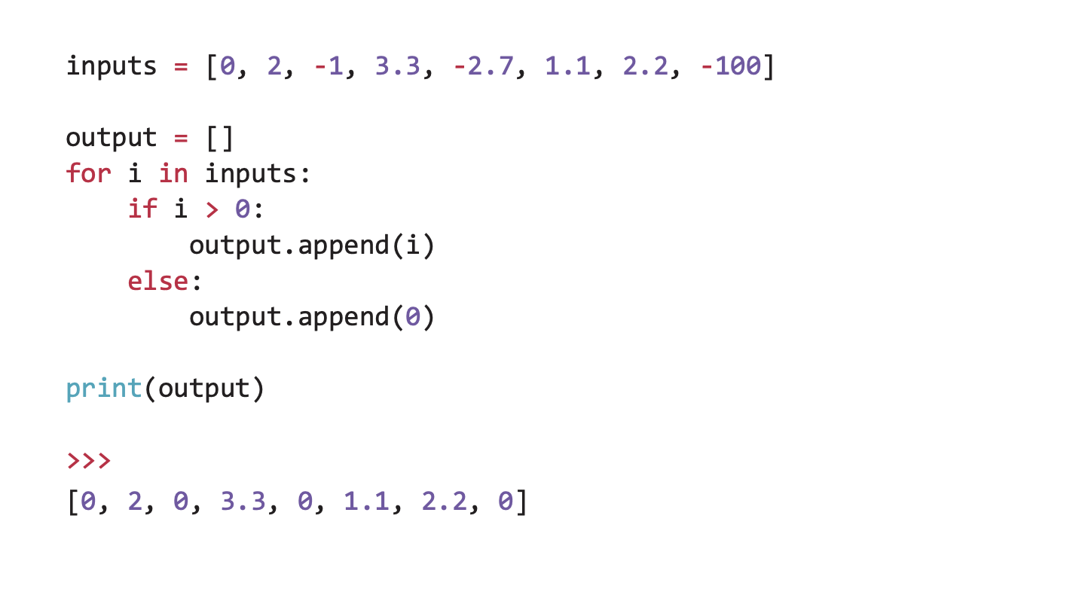
Despite the scary name…
Notes:
ReLU is actually (maybe obviously) very easy to implement and use in our code!
It’s basically just an if statement that checks if the value is greater than 0

Slide 28
Questions?

Slide 29
Let’s code ReLU

Slide 30
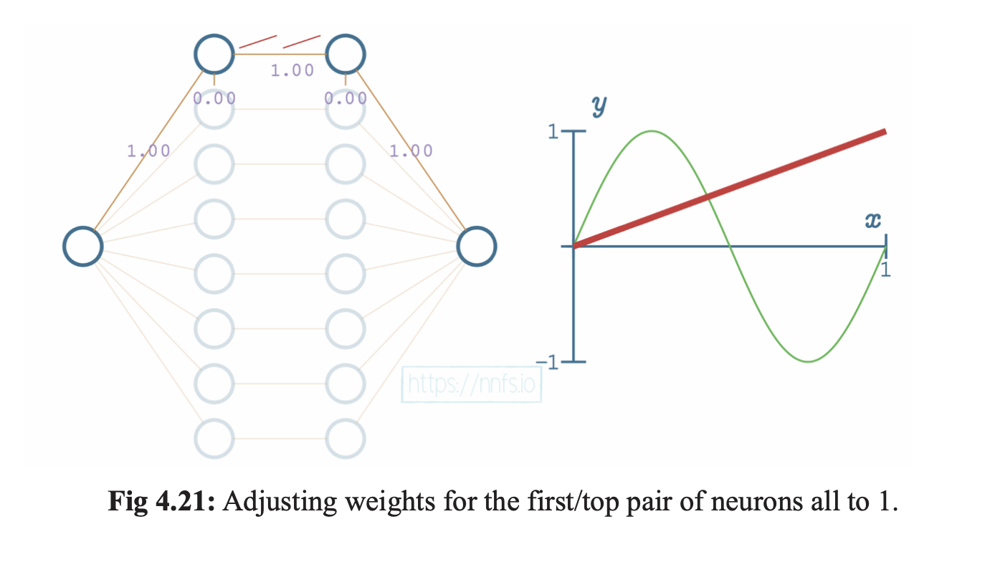
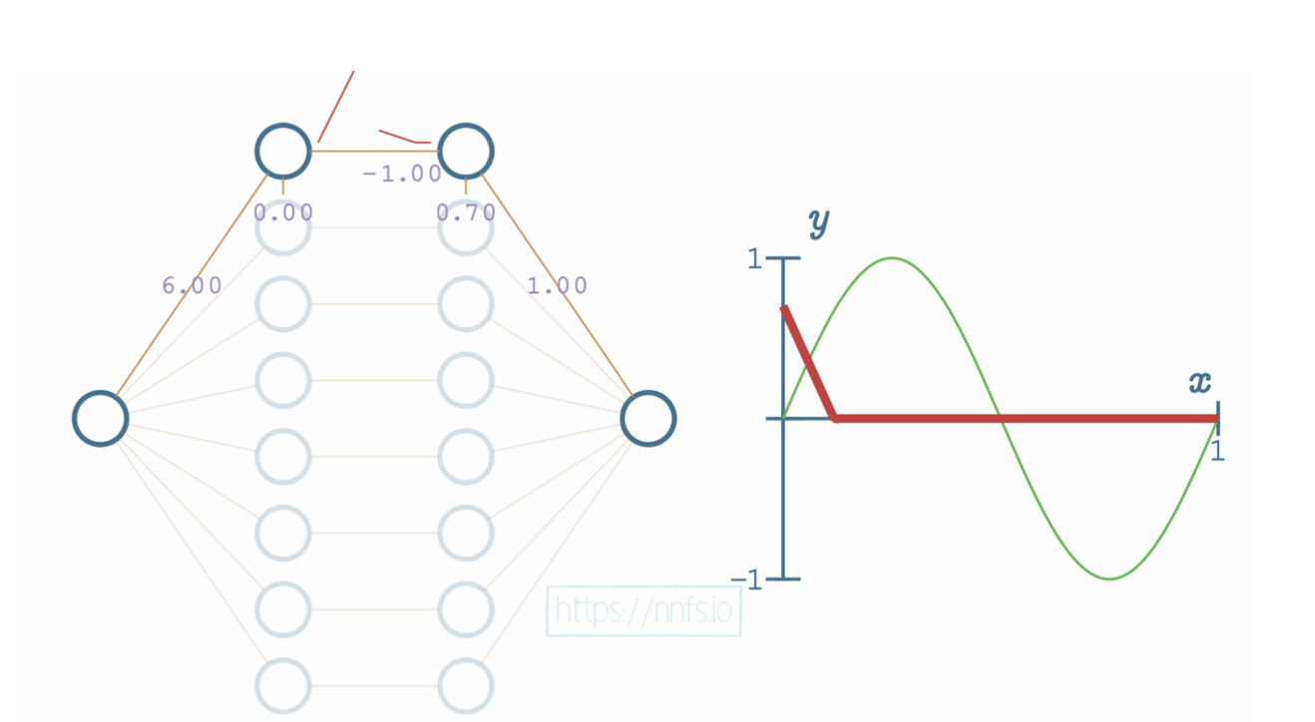
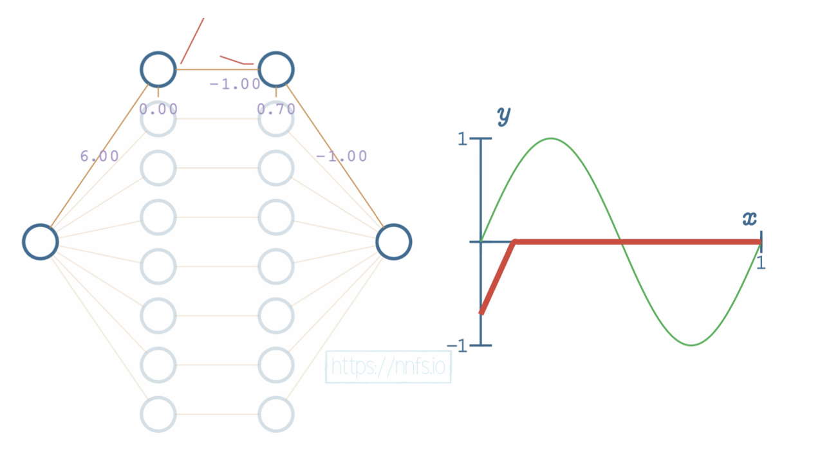
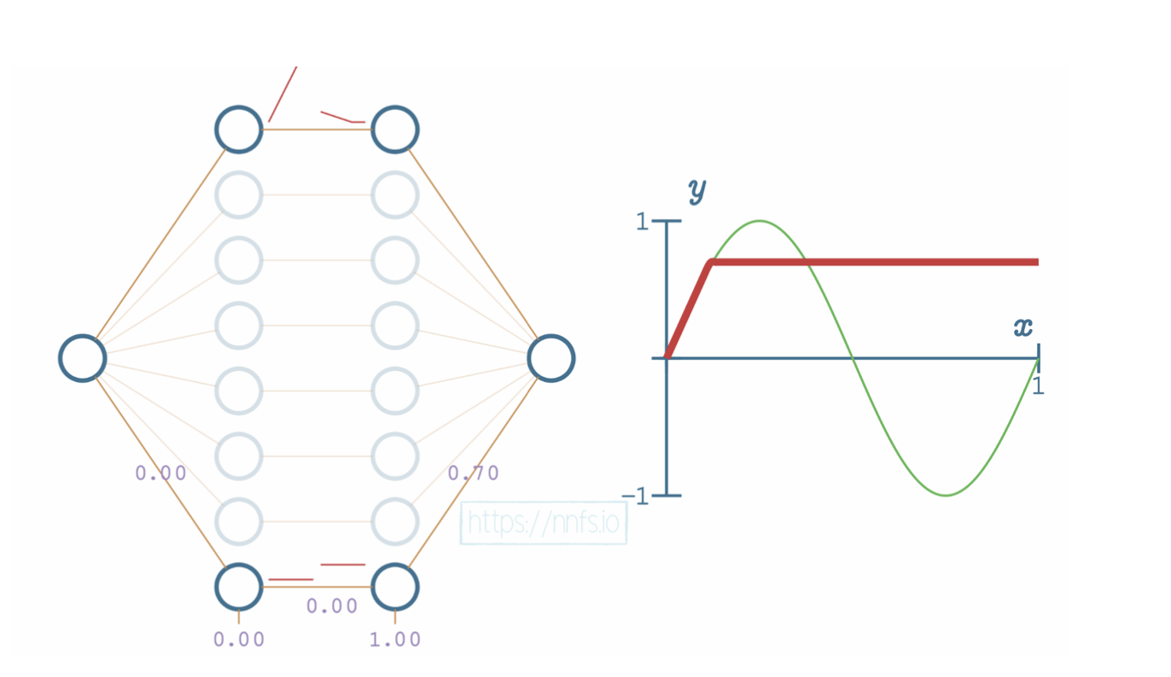
Notes:
Bit by bit, as we are training the function, we can adjust the output of our neurons to match the input labels

Slide 31
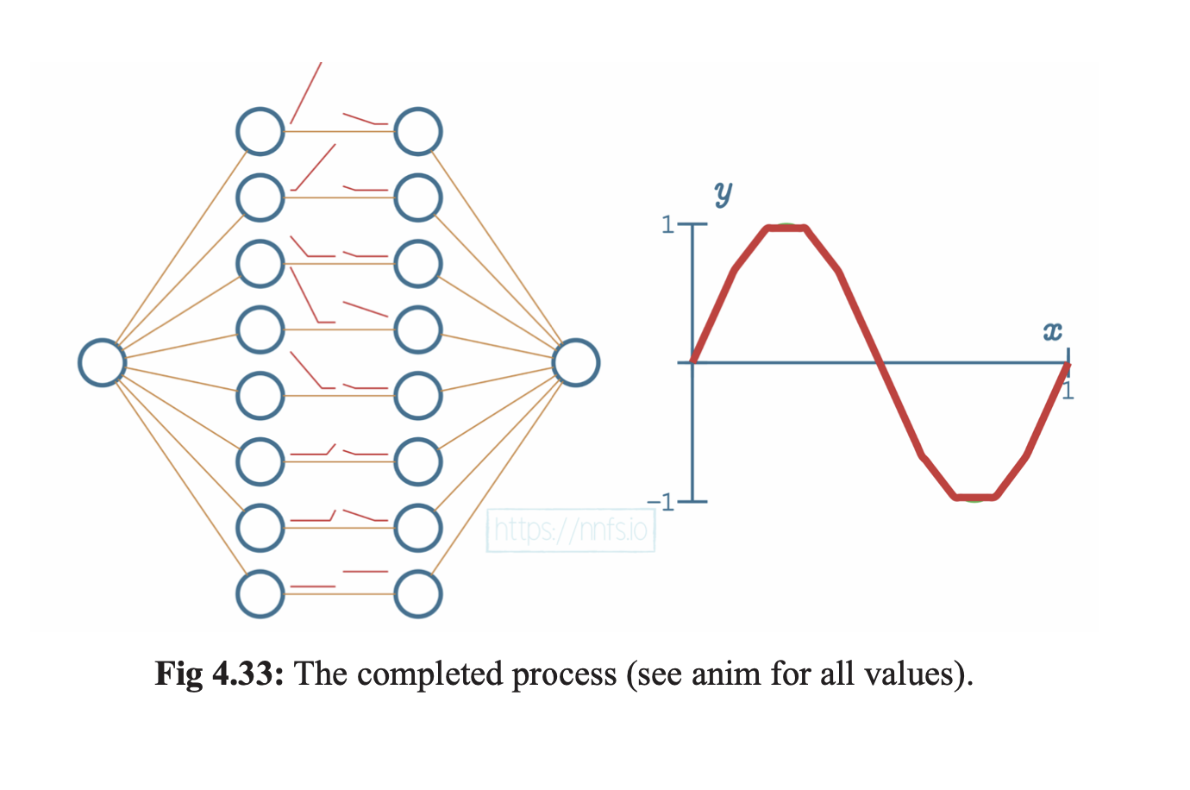
Notes:
The process from the previous slide is repeated for every neuron, and eventually we can fit y = sin(x)

Slide 32
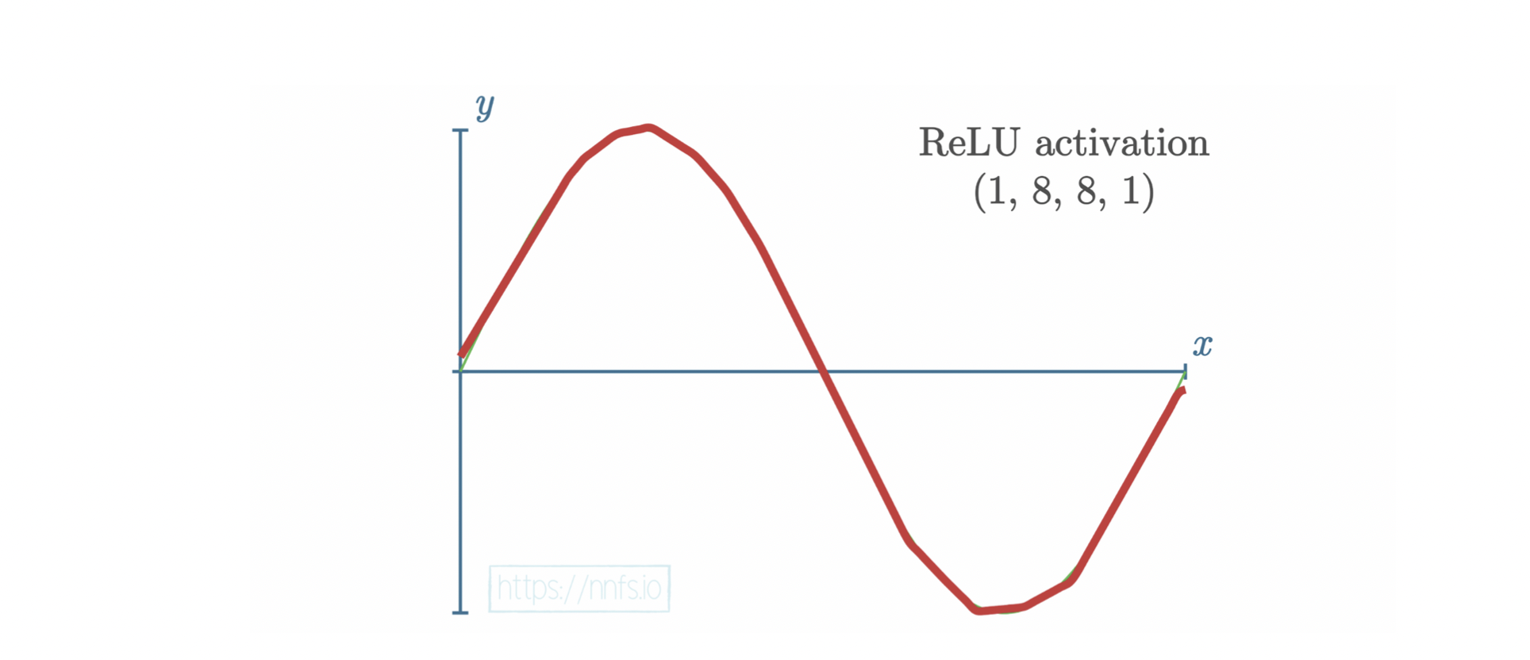
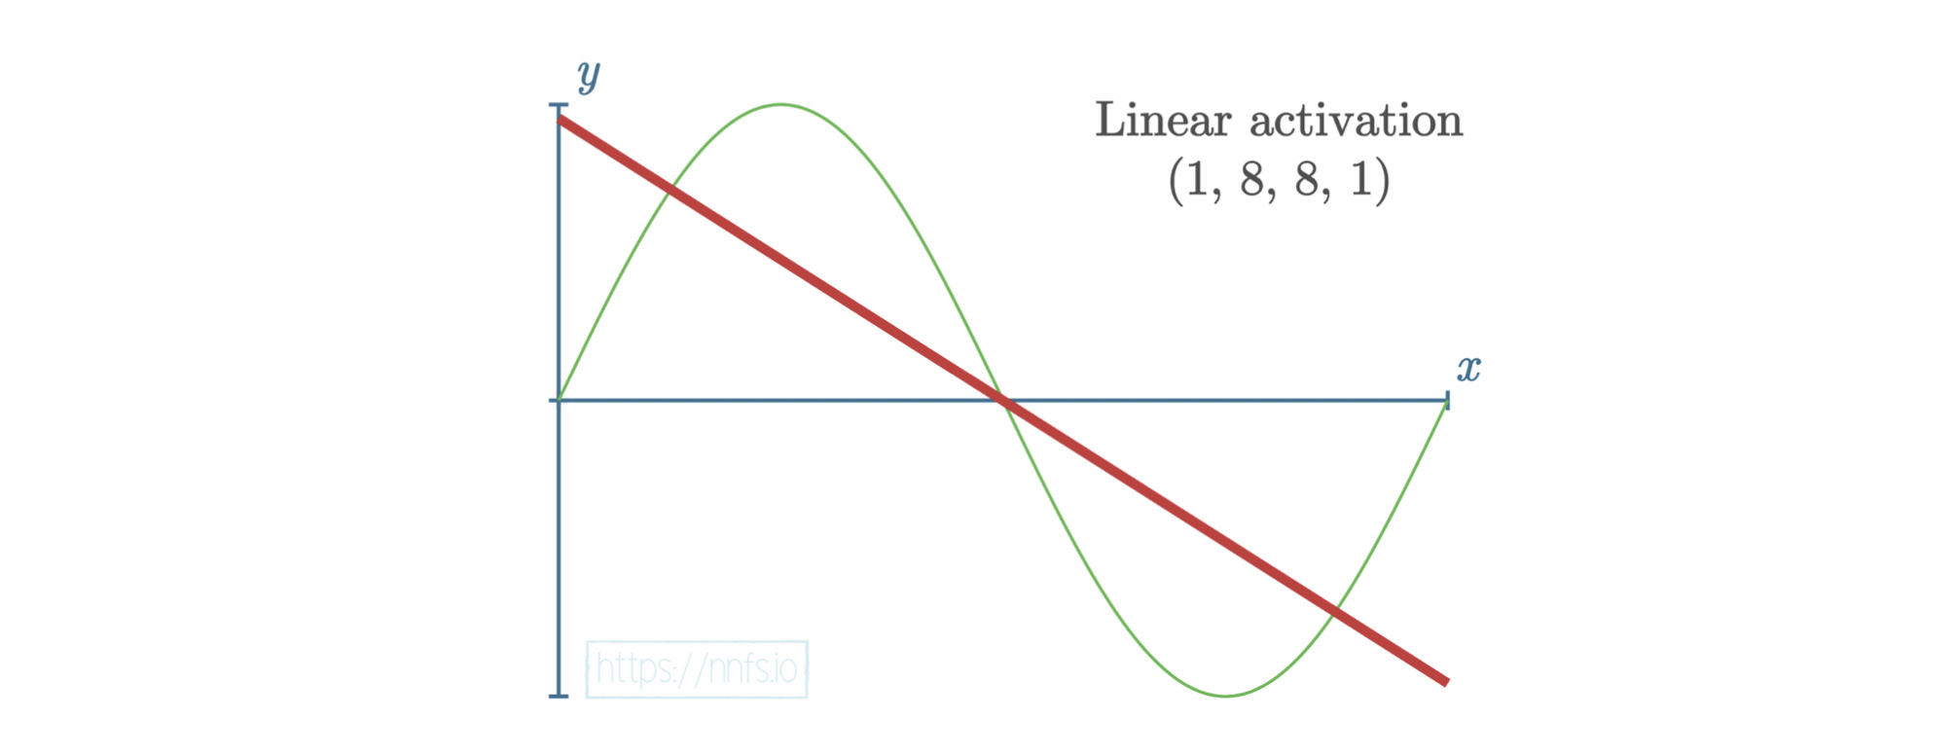
Effect of Activation Functions: Linear vs Simulated Nonlinear
Notes:
This shows just how much better ReLU is at fitting a nonlinear line than a typical linear activation would be (y = x)
Remember the linear activation from earlier? It is almost useless compared to ReLU

Slide 33
Important IDEA:
ReLU is great for training a network – but it does not work on the output layer!
A different function is needed for the output layers that can allow us to understand what the network is “thinking”

Slide 34
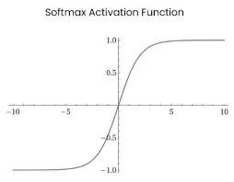
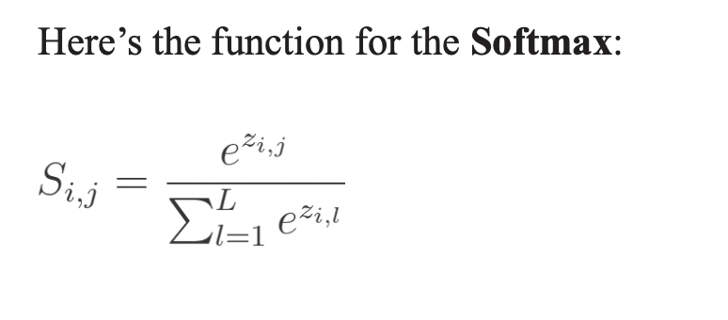
One Final Activation Function…
Notes:
What you need to know about Softmax is that it works on the output layer and through it’s equation creates a probability distribution.
Each output neuron in the final layer of the neural network represents a prediction, softmax will help us determine which prediction the network thinks is most likely.

Slide 35
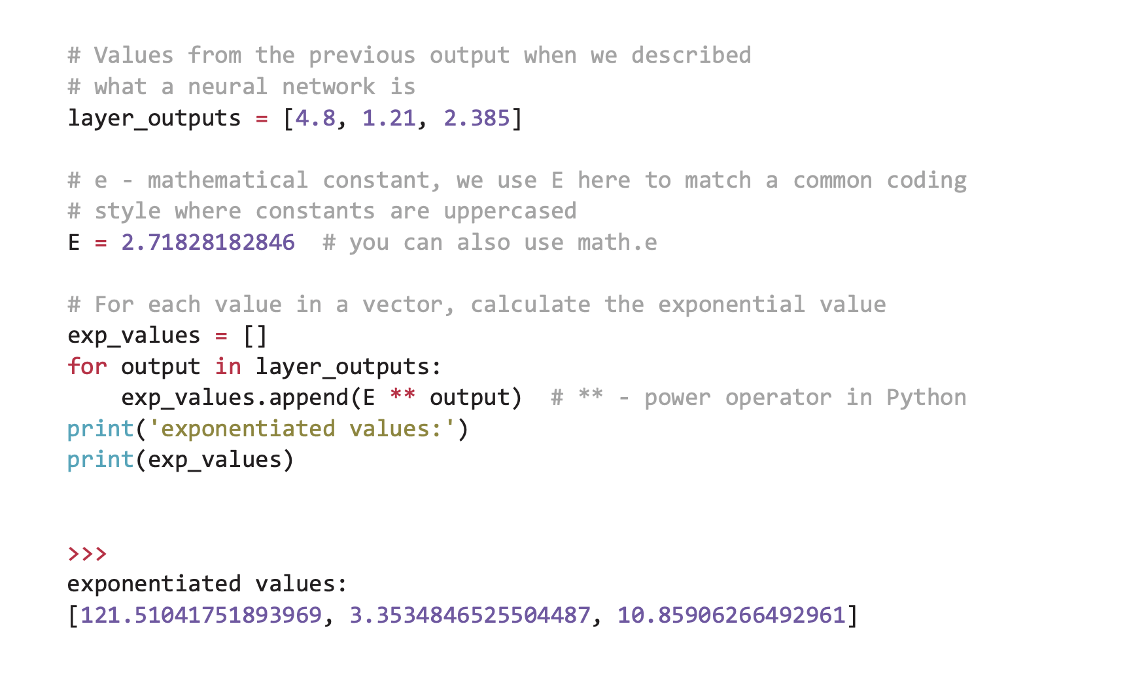
Softmax in python

Slide 36

Questions?

Slide 37
Let’s code Softmax

Slide 38

Calculating Network Loss

Slide 39
What is Loss?
In order to train a model, we need to know if the model is accurate or not
01
To calculate the error of the model we use a technique called calculating network loss (it tells us how wrong or right the network is)
02
To calculate loss we first need a loss function that can tell us how far off the network is from the correct values
03

Slide 40
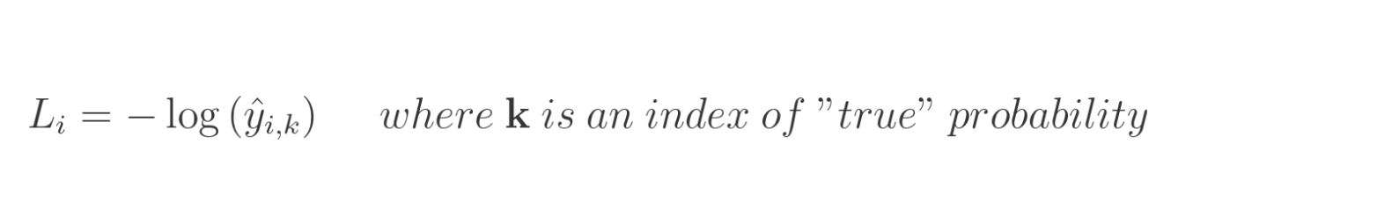
Categorical Cross Entropy Loss
Notes:
There are lots of different loss functions that you can learn and use, but we will only focus on categorical cross entropy loss to keep things a little more simple
Categorical cross entropy is great for models that use softmax as their final layer (normal for classification models)
CCE is also incredibly common as a loss function, and it is very simple to implement
In the above equation, L-sub i denotes sample loss value, i is the i-th sample of the data set, and k is the index of the label that corresponds to i-th sample
Finally, y-hat denotes the predicted value

Slide 41
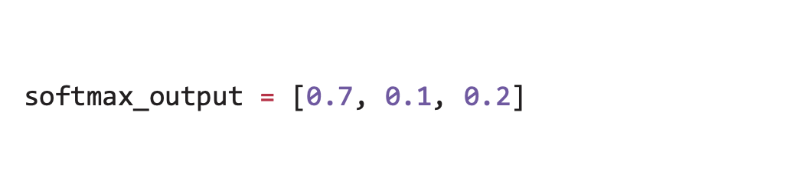
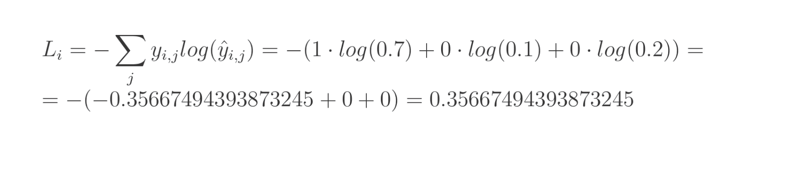
Using Softmax Output the Equation is:
Encoded = [0.7, 0.1, 0.2] = [1, 0, 0]
]
Notes:
In our data set we have three types of data: blue dots, red dots, and green dots – we need to figure out which one is the most likely and then calculate how far off we were from the right answer
If our softmax output was 1 for any of the categories, we would say that is a perfect score and the network can no longer improve
We are trying to get our softmax output as close to one for one of the outputs as possible

Slide 42
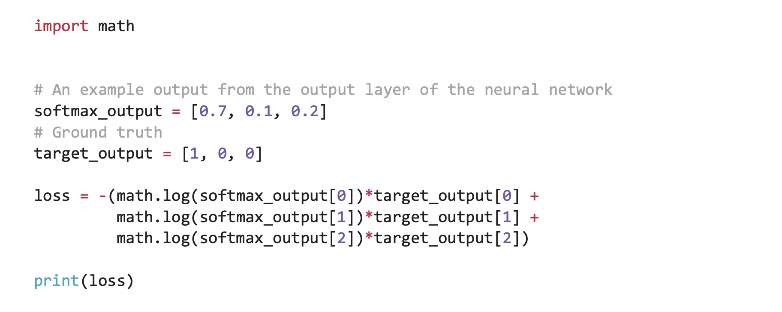
CCE Implementation is super simple!
Notes:
To implement categorical cross entropy loss it’s actually really easy
We are basically just taking the log of the product we get from multiplying our softmax output with our target output!
There isn’t much to it!
Something you should know is that in application, cross-entropy loss will output a bigger loss when the confidence of the output is lower! (remember we get the confidence of our output from the probability distribution that is created by our softmax function)

Slide 43
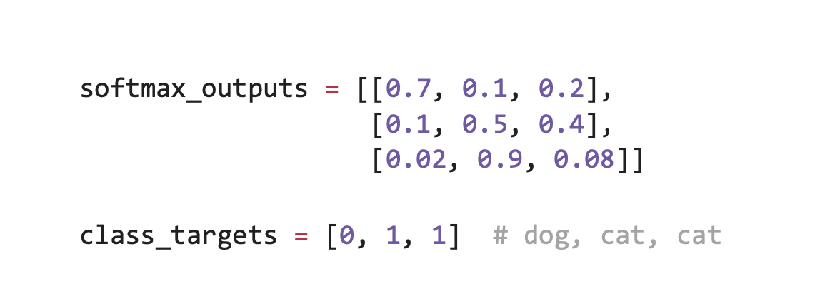
How do we apply our Loss Function?
We need to know which output was the most likely (meaning we choose the output from our Softmax function that was the largest / most “probable”
Once we figure this part out, we can just take the mean of the loss per batch of data to find the average loss of our network!
Notes:
In the first row of outputs, we apply our loss function to the 0 index because the max value in our Softmax output occurs at the first index!
In our second and third rows we apply our loss function to the 2nd index because that’s where the largest values are!

Slide 44
Let’s finish up by adding our loss function

Slide 45
Summary of Today’s Work
We reviewed our work from the previous session on creating individual neurons
We learned how to stack neurons into usable layers
We learned about activation functions and about how ReLU can be used to approximate complex functions (think about the Sine wave example)
We finished by discussing loss functions and how they can be used to figure out the error of our network which will help us train it better in the future!

Slide 46

Thank you

